Slide 1
What do Scientists do?
Why is it important?

Slide 2
What is science?
How many times have you heard/read the following:
“according to a recent scientific study…”
The study of … well everything!
How do things affect other things?
What materials make for the best ________?
Which brand of baby formula increases a child’s intelligence? What specifically makes it different?
At what temperature do soy beans grow best?
How can we make fuel out of waste?
Etc…

Slide 3
A Scientist’s job
Scientists come up with ways of answering questions using logic so that their results can be repeated and withstand criticism
Design an experiment to test the soybean question from the last page. Take 5 min.

Slide 4
An Engineer’s Job
Engineers use scientific and mathematical principles to solve problems.
Design a greenhouse to keep soybeans at the ideal temperature during cultivation. Take 5 minutes.

Slide 5
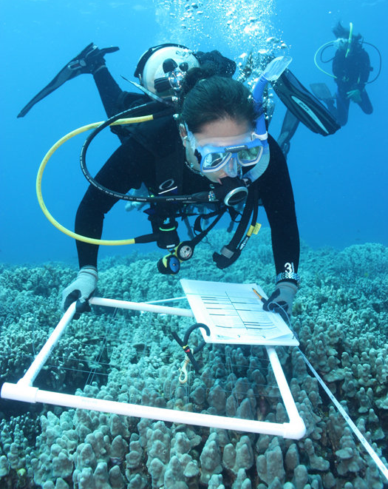
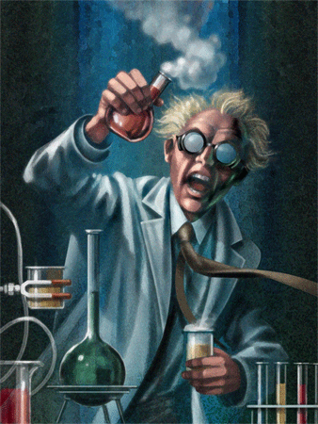
Who are scientists?

Slide 6
This is science?

Slide 7
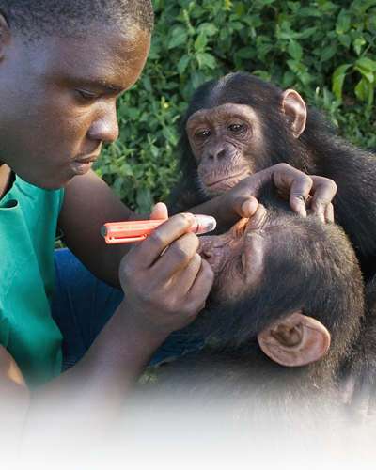
Like animals?

Slide 8
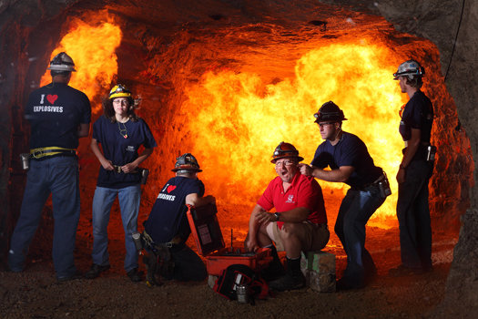
Like things that go boom?
Notes:
Missouri University of Science and Technology: Experimental Mine
John B. Carnett
Career: Industrial demolitions Learn to: Blow things up extremely well

Slide 9
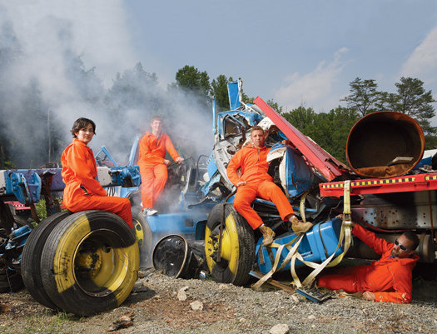
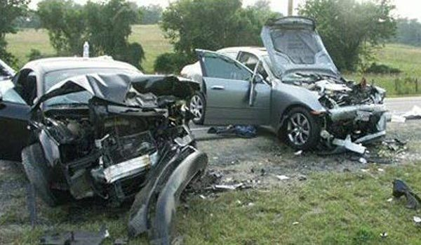
Things that go crunch?
Notes:
George Washington University: National Crash Analysis Center
John B. Carnett
Career: Safety engineer Learn to: Propel a sedan at 60 mph into a roadside planter

Slide 10
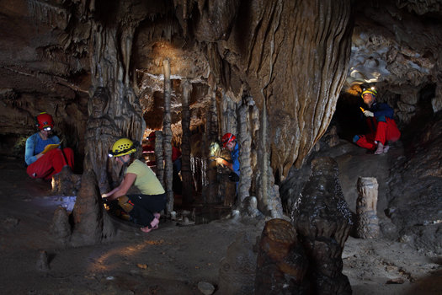
When are you inside but outside? In a cave!
Notes:
Northern Kentucky University: Barton Lab
John B. Carnett
Career: Geologist Learn to: Study Martian living conditions here on Earth

Slide 11
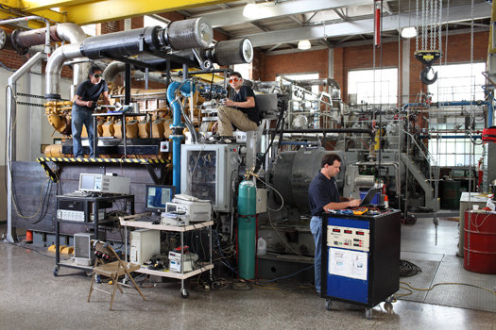
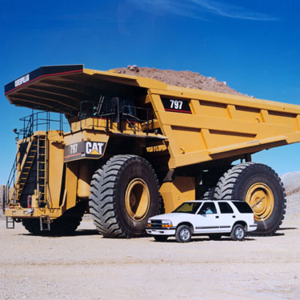
Like working on engines? Why stop at cars?
Notes:
Colorado State University: Engines and Energy Conversion Laboratory
John B. Carnett
Career: Mechanical engineer Learn to: Make a 2,300hp engine stronger and cleaner

Slide 12
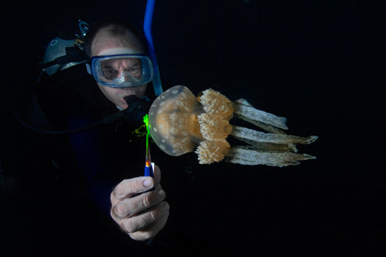
Like diving?
Notes:
University of California at Merced: Dawson Lab
Career: Marine biologist Learn to: Dive with jellyfish

Slide 13
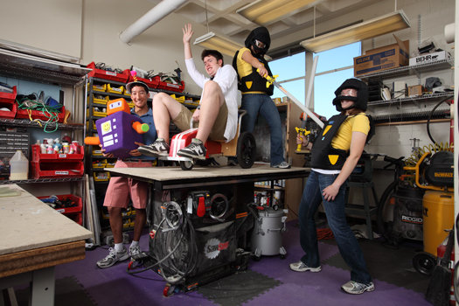
Like to play with toys? Try designing them!
Notes:
Massachusetts Institute of Technology: Toy Lab
Career: Toy designer Learn to: Build toys and test them on actual kids

Slide 14
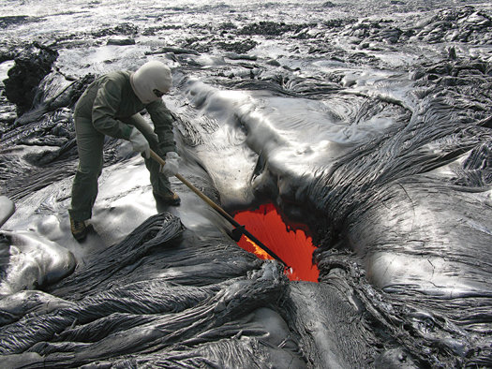
Is it cold outside…or really hot?
Notes:
U.S. Geological Survey: Hawaiian Volcano Observatory
Courtesy U.S. Geological Survey/Hawaiian Volcano Observatory
Career: Geophysicist Learn to: Measure lava flow on volcanoes

Slide 15
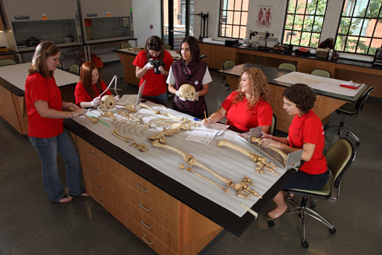
I see dead people…for a job!
Notes:
North Carolina State University: Forensic Analysis Lab
Career: Forensic investigator Learn to: Analyze human remains

Slide 16
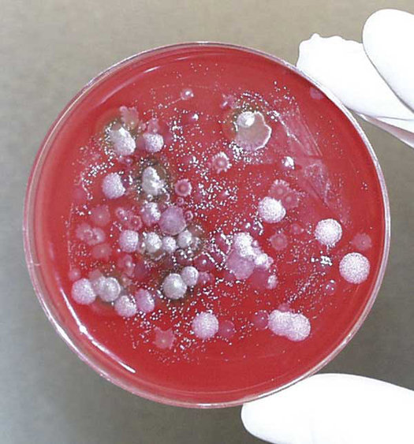
What happens when you don’t wash your hands? Bacteria and viruses!
Notes:
Boston University: National Emerging Infectious Diseases Laboratory
Centers for Disease Control
Career: Bird-flu researcher Learn to: Study pathogens with leading infectious-disease specialists

