Slide 1
SI Measurement System

Slide 2
The International System of Units (SI)
The International System of Units (SI) is a system of units of measurement consisting of seven base units
Mostly widely used system of measurement
United States is the only industrialized nation that has not adopted the SI system
Unit Name | Symbol | Measurement
meter | m | length
kilogram* | kg | mass
second | s | time
ampere | A | electric current
kelvin | K | thermodynamic temperature
candela | cd | luminous intensity
mole | mol | amount of substance
Notes:
Note that even though kilogram has the kilo- prefix, it is defined as a base unit and is used in definitions of derived units.

Slide 3
The International System of Units
Often referred to as the metric scale
Prefixes indicate an integral power of 10
Power of 10 | Prefix | Abbreviation
10¹ | deca- | da
10² | hecto- | h
10³ | kilo- | k
10⁶ | Mega- | M
10⁹ | Giga- | G
10¹² | Tera- | T
Power of 10 | Prefix | Abbreviation
10⁻¹ | deci- | d
10⁻² | centi- | c
10⁻³ | milli- | m
10⁻⁶ | micro- | µ
10⁻⁹ | nano- | n
10⁻¹² | pico- | p
Notes:
Note that the kilo- prefix in kilogram indicates that a kilogram is 10^3 = 1000 grams. The fact that the kilogram is a base unit does not affect the meaning of the prefix but allows for the use of the kilogram as a unit in the definition of derived units.
[These, and additional prefixes are shown on the PLTW Engineering Formula Sheet. Students do not need to write these prefixes in their notes.]

Slide 4
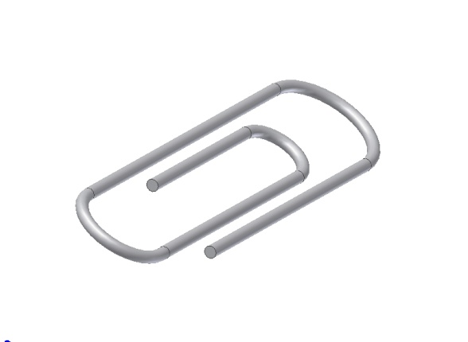
Common Items: Size Comparison
Two sheets of paper | Human hair | Diameter of paper clip
0.2 mm. | 0.1 mm | 0.8 mm
U S Customary System
S I
Notes:
Students can understand more when you relate to common objects.

Slide 5
Recording Measurements
Measurements must always include units
Always errors in measurements
measurements are the best “estimate” of a quantity
A measurement is only good if you know that it is reasonable close to the actual quantity
It is important to indicate the accuracy and precision of your measurements
Scientists and engineers use significant digits to make the accuracy and precision of measurements clear
Notes:
Be sure to always include units when recording measurements.
There are always errors in measurements, even if they are very small. It is important to know the level of error that may be inherent in a measurement.
It is important to understand how accurate the recorded measurement is. For instance, if you know an object measures 3 inches in length, you can’t really be sure if the object is actually somewhat longer or shorter than 3 inches. Perhaps the object is 3 1/16 inches long, or 2 15/16 inches long. If the object must fit into a 3 inch space – which again may be somewhat larger or smaller than the recorded measurement. How can you be sure the part will fit?

Slide 6
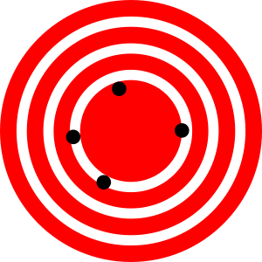
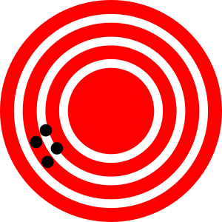
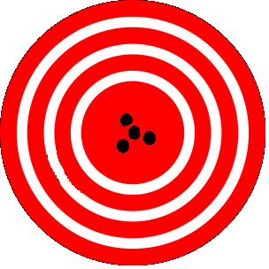
Precision and Accuracy
Precision (repeatability) = the degree to which repeated measurements show the same result
Accuracy = the degree of closeness of measurements of a quantity to the actual (or accepted) value
High Accuracy
Low Precision
High Precision
Low Accuracy
High Accuracy
High Precision
Notes:
Although precision and accuracy are often confused, there is a difference between the meanings of the two terms in the fields of science and engineering.
Precision indicates how close together repeated measurements of the same quantity are to each other. So, a precise bathroom scale would give the same weight each time you stepped on the scale within a short time (even if it did not report your true weight).
Accuracy indicate how close measurements are to the actual quantity being measured. For example, if you put a 5 pound weight on a scale, we would consider the scale accurate if it reported a weight of 5 pounds.
A target analogy is sometimes used to differentiate between the two terms. Consider the “arrows” or dots on the targets to be repeated measurements of a quantity.
[click] The first target shows that the arrows (or repeated measurements) are “centered” around the center of the target, so on the whole, the measurements are fairly close to the target (actual) measurement – making the measuring devise accurate. But the repeated measurements are not close to each other - so the precision of the measuring device is low. , although they are not close to each other.
[click] The second target show that the arrows (or repeated measurements) are close together – so the precision is high. But the “center” of the measurements is not close to the target (actual) value of the quantity.
What should the target look like if the measurement is both highly accurate and highly precise? [allow student to answer then click]. The third target shows both precision (because the measurement are close together) and accuracy (because the “center” or the measurements is close to the target value).

Slide 7
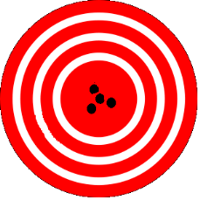
Recording Measurements
Ideally, a measurement device is both accurate and precise
Accuracy depends on calibration to a standard
Precision depends on the characteristics and/or capabilities of the measuring device and its use
Use significant digits to indicate the accuracy and precision of experimental results
Record only to the precision to which you and your measuring device can measure

Slide 8
Significant Digits
Accepted practice in science is to indicate accuracy and/or precision of measurement
Significant digits are digits in a decimal number that carry meaning contributing to the precision or accuracy of the quantity
The digits you record for a measurement are considered significant
Include all certain digits in a measurement and one uncertain digit
Note: fractions are “fuzzy” numbers in which significant digits are not directly indicated
Notes:
Laying tile involves accuracy, so significant figures are useful. Let's say you want to know how wide 10 tiles would go. You measure one tile and you get 11 7/8 inches on one side of the tape measure and 30.2 centimeters on the other side. If you convert 11 7/8 inches to decimal fraction, you get 11.875 inches. That implies accuracy down to a thousands of an inch. That isn't true because the tape can't measure to the nearest thousandths of an inch. Only to the nearest 16th of an inch. So significant numbers are easier to determine when a measurement is done with decimal fractions.

Slide 9
Recording Measurements
Manufacturers of equipment usually indicate the accuracy and precision of the instrument
General Rules
Digital Instruments – read and record all the numbers, including zeros after the decimal point, exactly as displayed
Decimal Scaled Instruments – record all digits that you can certainly determine from the scale markings and estimate one more digit
Preferred over fractional scaled instruments
Fractional Scaled Instruments – need special consideration
Notes:
We will concentrate on measuring and recording linear length measurements in this presentation, but the techniques discussed apply to all types of measurements.
We’ll look at an example of a decimal scaled instrument first – a metric scale. Later we’ll talk about a fractional scale – a ruler divided into fractions of inches.

Slide 10
Metric Scale
A typical metric scale often includes a 30+ centimeter graduated scale
Each centimeter is graduated into 10 millimeters

Slide 11
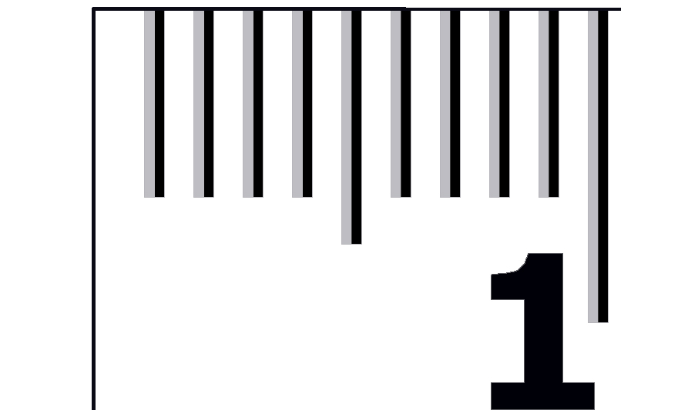
The Millimeter
The millimeter is the smallest increment found on a typical SI scale
1 mm

Slide 12
The Millimeter
The next larger marking on a SI scale shows 5 millimeters
5 mm

Slide 13
The Millimeter
Largest markings on a SI scale represents centimeters (cm)
These are the only marks that are actually numbered.
1 cm = 10 mm

Slide 14
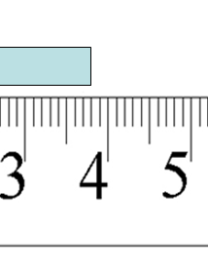
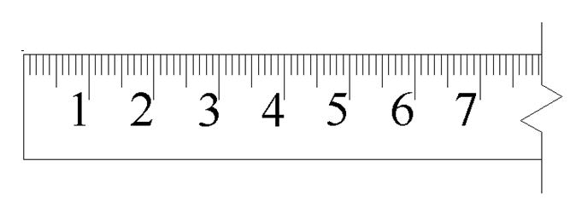
Measurement: Using a Decimal Scale
How long is the rectangle?
Let’s look a little closer
Notes:
Let’s look a little closer. [click]

Slide 15
Measurement: Using a Decimal Scale
How long is the rectangle?
Notes:
You can tell that the length of the rectangle is between 3 and 4 centimeters. [click]
And, because the scale is incremented in millimeters, you can also be certain that the measurement is between 3.8 and 3.9 centimeters (assuming the scale is accurate). So, you are certain that the first digit after the decimal, the tenths place, is 8. [click]
But, because there are no tick marks between millimeter marks, you can only estimate the hundredths place of the measurement. Perhaps you would estimate 3.83 or 3.84 cm. The last digit is an estimate – your best guess as to where, within the millimeter distance, the measurement falls.

Slide 16
Recording a Measurement
How long is the rectangle?
Remember the General Rule
Decimal Scaled Instruments – record all digits that you can certainly determine from the scale markings and estimate one more digit
Best Estimate = 3.84 cm

Slide 17
Recording a Measurement
How long is the rectangle?
Remember the General Rule
Decimal Scaled Instruments – record all digits that you can certainly determine from the scale markings and estimate one more digit
Best Estimate = 3.84 cm
Certain
Notes:
Since the measurement is certainly between 3.8 and 3.9, you can be certain that the 3 and the 8 are correct. However, the 4 is an estimate based on your best guess.
This number has three significant digits : 3, 8 and 4.

Slide 18
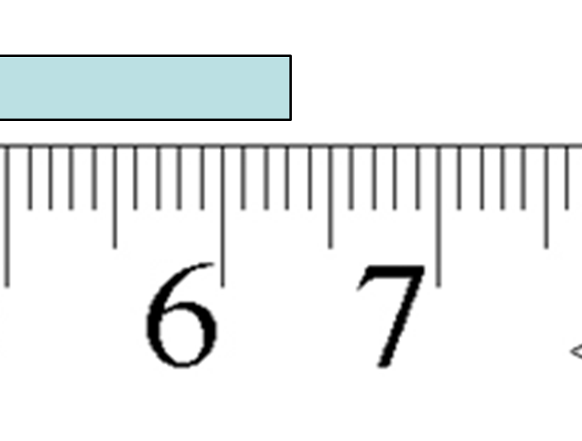
Your Turn
How would you record the length of this rectangle?
How many significant digits?
6.33 cm
3
Notes:
[click to zoom in on scale. Allow student to estimate the measurement.]
[click to reveal estimate of 6.33 cm.]
Answers may vary, but a good estimate that reflects the appropriate precision is 6.33 cm. Other good estimates are 6.32 or 6.34 cm.
[Click and allow students to answer question then click again to reveal answer of 3.]

Slide 19
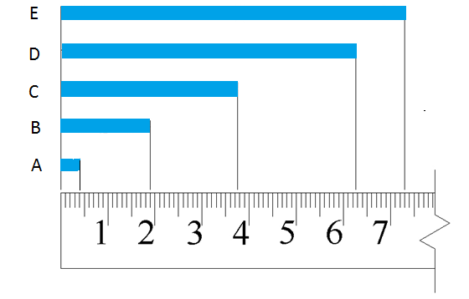
Your Turn
Record each measurement in centimeters using the appropriate number of significant digits.
Notes:
[The teacher will pass out Activity 1.3.1 Linear Measurement and have students answer complete the metric linear measurements.]

